Slide 1
PFE Team Orientation (k-8)

Slide 2
Sffc -
Who we are
Nonprofit based near Nashville, TN
Mission: Create opportunities for service and mentorship, and support the families who are in our programs with tuition assistance
Current initiatives include
PFE Program (since 2006)
TCH Program (tutoring, since 2023)
Grants for individuals & families within our partner communities

Slide 3

PFE Origin story

Slide 4
K-8 program Basics
School applies annually
Participants are matched with an older adult mentor in community
Students visit mentors for 1 hour per week + submit a 'reflection' after each visit
Selection of PFE participants
(spots based on enrollment)
Mentor receives blessings of an adopted ‘grandchild,’ company, and help around the home
Students receive the blessings of an adopted 'grandparent,' the joy of service, and tuition assistance

Slide 5
Team member responsibilities
Principal
Select PFE coordinator – “local champion”
Support coordinator during student/parent orientation
Create and execute a fundraising plan for 30% of scholarship
Share PFE with your school families
Treasurer
Provide support at student/parent orientation
Keep track of 30% fundraising required for PFE
Apply funds for scholarship recipients (sent monthly)

Slide 6
Team Member responsibilities, cont.
Coordinator
Select PFE participants
Hold student/parent orientation (prior to visits starting)
Approve student/mentor matches (see mentor profiles)
Verify mentors understand PFE programming and guidelines (mentor packets)
Provide support to students, parents, and mentors
Review and approve visit reflections weekly
Check in with mentors each month
Complete end-of-year survey
Pastor – if any area churches
Work with coordinator to identify potential mentors
Promote PFE to your congregation(s)

Slide 7
Student Selection
Based on enrollment:
30 or below can have 50% participate
31+ can have 20% participate (max 40)
Should be chosen based one of the below -
  Passion or interest in serving
  Need for mentorship
*Financial need should not be a consideration or criteria
Our goal is not just for you to have a full program!
It is for you to have participants that value the non-financial impact of PFE and are happy to follow the guidelines.

Slide 8
Student/parent orientation
You are required to hold a yearly orientation for students and parents.
Orientation:
Required for new and returning students
Must take place before students start visiting
PowerPoint and student packet are provided by SFFC (link below)
Suggestions – hold on a Sunday or after school in July/Aug and invite any interested families or meet one-on-one with families who are interested or that you have identified as a good fit
https://www.sffcfoundation.org/pfe/resources

Slide 9
Student/mentor matches
PFE was designed to ease senior isolation.
A mentor must be an older adult (age 55+) or someone with a disability. Maybe someone who could use companionship or light help around the home.
Mentor Selection
Families can choose their own mentors (1 for each child), your team may provide a list of suggested mentors from your community, or you can pair up students and mentors.
Criteria for mentors:
No nursing home residents (assisted living + independent living are acceptable)
Cognitive health
Commitment: A mentor must be willing to visit with their mentee on a weekly basis, throughout the school year
  Being gone for the occasional holiday or trip is okay. Mentors gone for 1+ months out of the school year are not a good fit.
Students may not be matched with a relative by any degree

Slide 10

Mentor support
Beginning of the year –
You are required to meet with each mentor at the beginning of the year to provide the mentor packet and ensure they understand the intention of the program.
Monthly –
You will need to check in with them and fill in the mentor check-in form (on the reflection website) confirming your communication. You should be asking them questions such as:
How are visits going?
Do they need any support or extra resources from you?

Slide 11
PFE Visits
One hour long
Once per week (Aug-May)
With the same mentor
  Occasionally a mentor does change (moving, not right for the program, passing away) so if the family communicates, you can approve them choosing a new mentor for the rest of the year
Visits should happen at or around the mentor’s home (if unique situation or requests comes up, contact PFE)
Parent/guardian must attend and supervise every visit
Make-up Visits
Max of 1 per month
Must be on a separate day than regular visit

Slide 12
What should a visit look like?
Activities often include:
Helping with chores​
Cooking/baking​
Crafts and art​
Playing games​
Going for a walk​
Gardening​
Reading a book​
Doing homework
Unacceptable Activities -
Watching movies/TV
Attending events (school, church, community)
Anything where the student and mentor are not interacting or together
Example Reflection
“I went to visit Miss Linda today. First, we talked about how our day went. I told her about school and the test I took. I got a B+! She said she was proud of me. I also told her about my dentist appointment today. I got my teeth cleaned. She said she spent most of her day outside in the garden. We shared jokes back and forth and then we had a snack. At the end of our visit, we played monopoly and I won! It was so fun.”

Slide 13
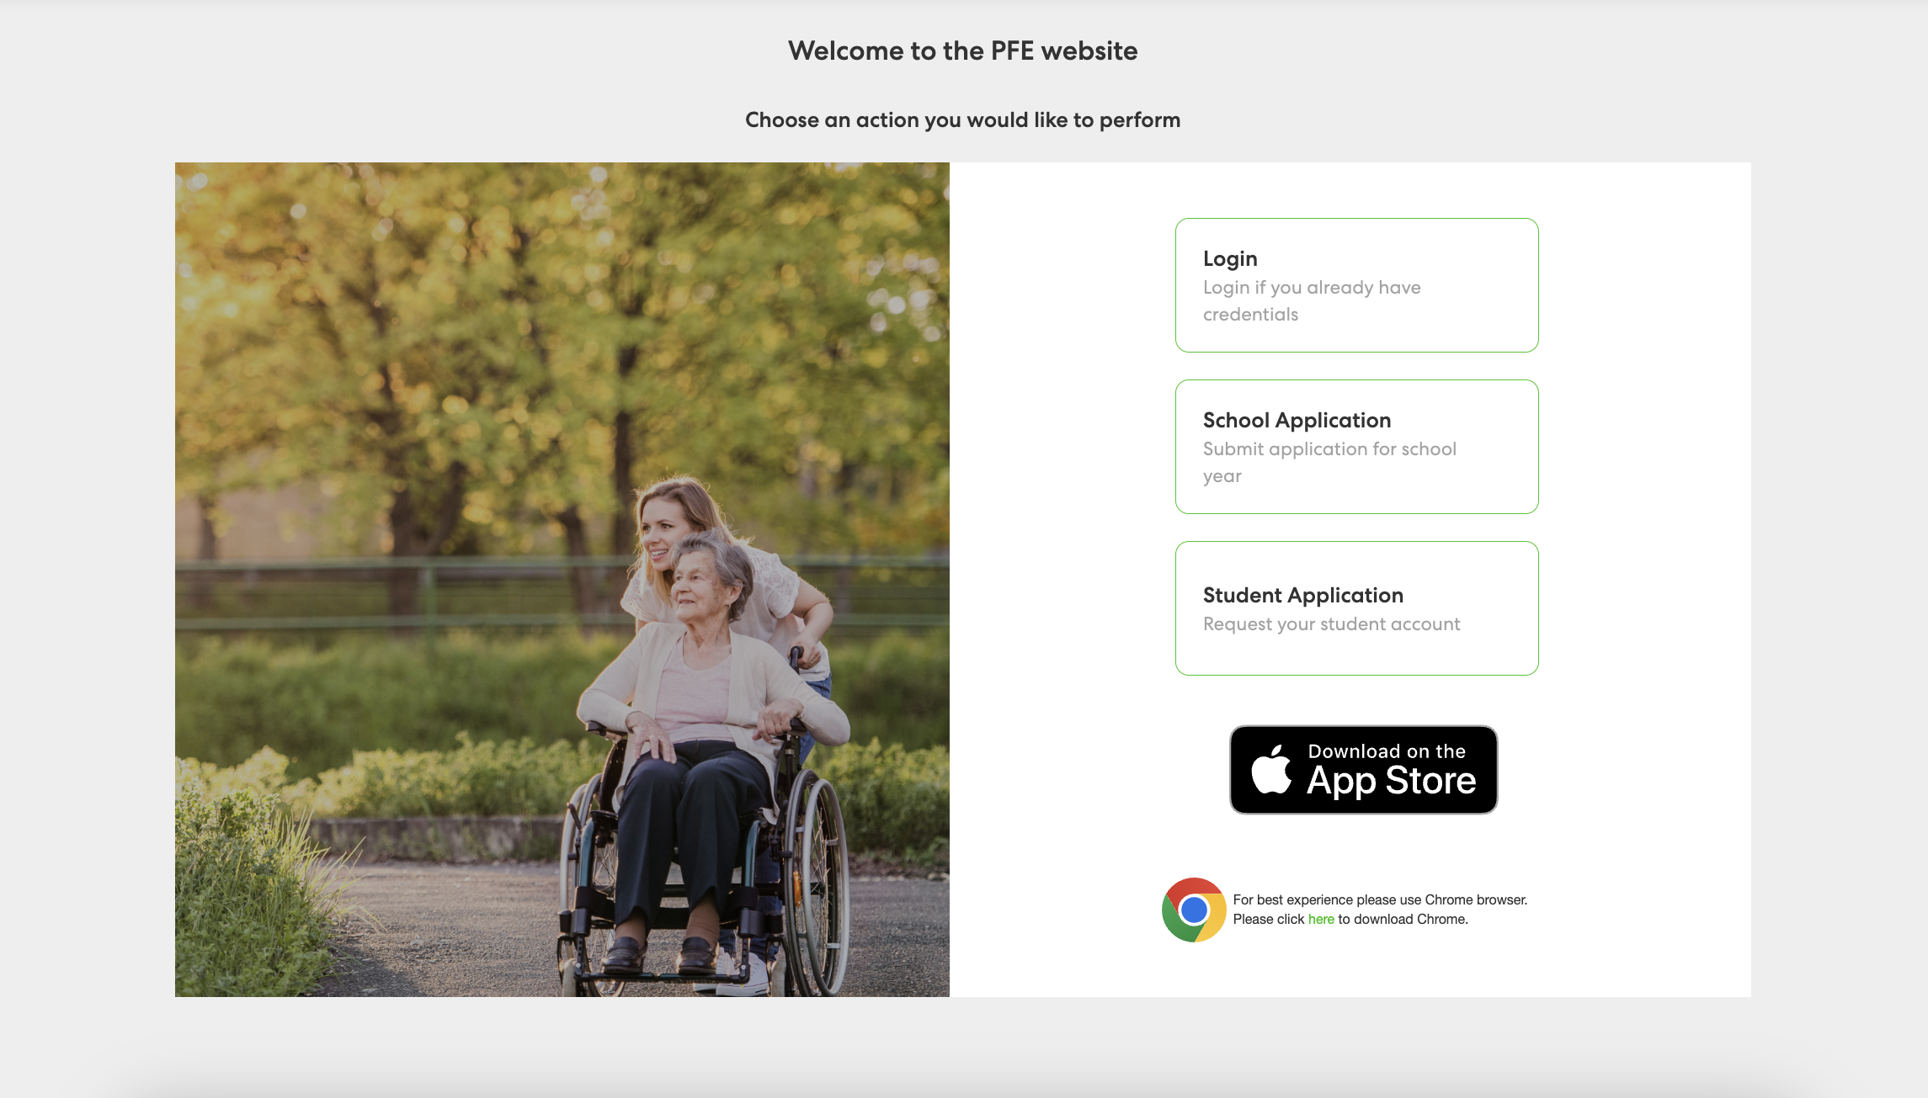
Reflection website

Slide 14
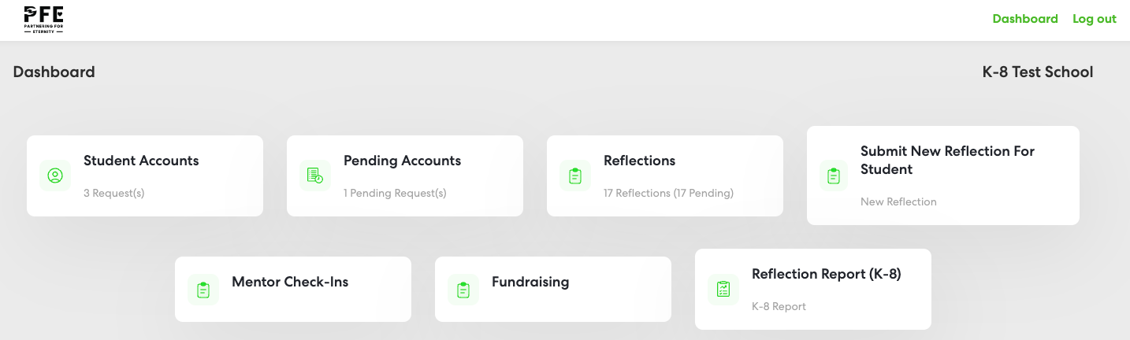
Admin dashboard

Slide 15
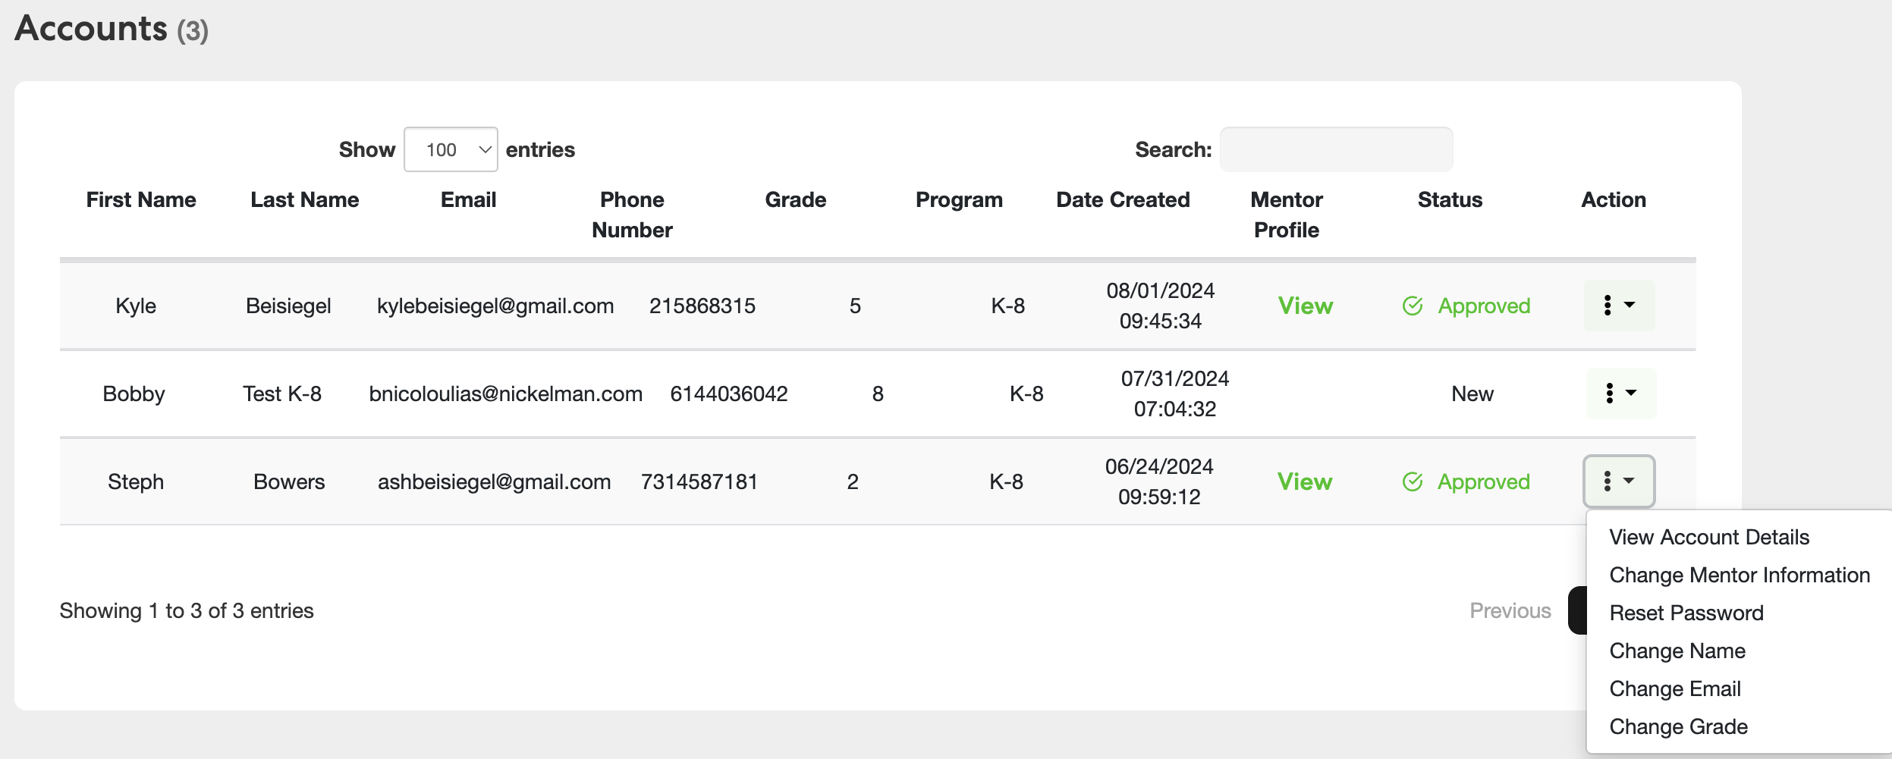
Student Account view

Slide 16
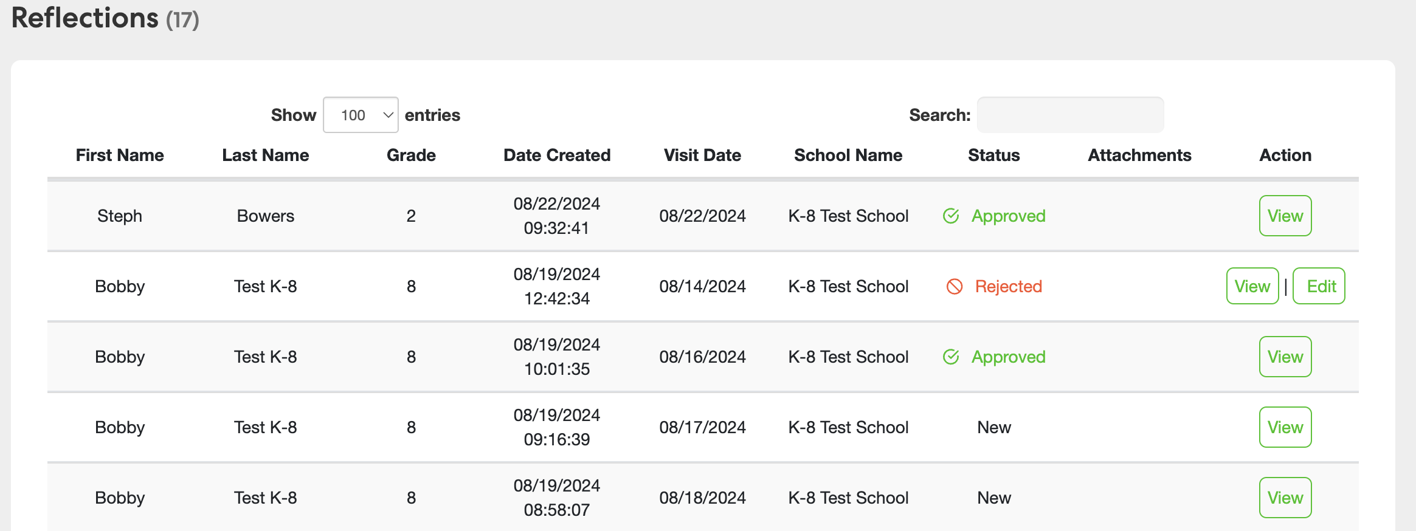
Reflection view

Slide 17
Reflections
Reflections that should be rejected
“We went to the park. It was fun.”
Submitted within 24 hours of each visit
Sentences
  K-3 grade = minimum 3 sentences
  4-8 grades = minimum 5 sentences
Details - every reflection should be answering the following:
  What activities or service did you do together?
  What did you talk about during your visit?
  What did you learn from or about your mentor OR what did you share with or teach them?
Coordinator reviews weekly
Student/parent receives email (and text if opted in) when you approve or reject their reflection. Rejected reflections have 4 days to be edited and resubmitted.
”We baked cookies. We hugged. We went home.”
“I folded laundry at Miss Sheila’s house. There was a lot of laundry. I was so tired when I was done.”
“Amy picked me up from school today because my mom was still at work. We talked on the drive home and then watered her garden until mom get to get me.”
PFE App is available! Encourage families to download and use it to submit reflections.

Slide 18
Monthly scholarship
Students receive $30 per weekly visit towards tuition
Funds sent monthly based on approved reflections
70% ($21) given by SFFC and 30% ($9) fundraised locally
You have one week at the end of each month to review any final reflections.
Do not wait until the end of the month to review all reflections. If you forget or miss the deadline, your students will not receive scholarship.
After the 7th, no additions or changes will be accepted.
Scholarship is processed on the 8th and sent within a few days.

Slide 19
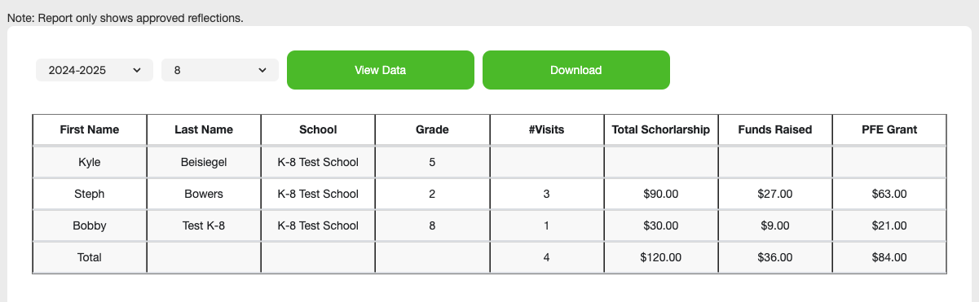
Reflection Report

Slide 20
Surveys
Entry + Exit for students and mentors
Students submit inside their PFE accounts
Mentors are emailed a welcome letter and their survey link (you may have to follow up with a few if they don’t have email or internet access)

Slide 21
Have questions or need help?
The PFE Team is here to support you so please reach out if you need anything!
Phone: (615) 675-0450
Email: pfe@sffcfoundation.org

